Slide 1
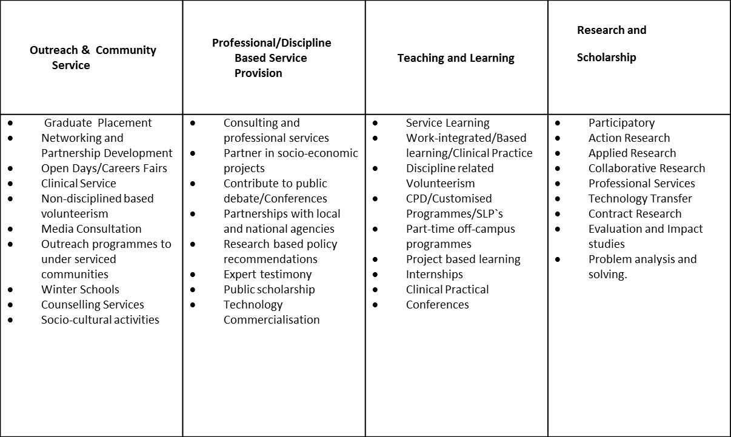
The NMMU Engagement Conceptual Framework and Typology

